Slide 1
Solar image color tables and their perception
J. Ireland, M. S. Kirk
borrowing heavily from the matplotlib colormap pages

Slide 2
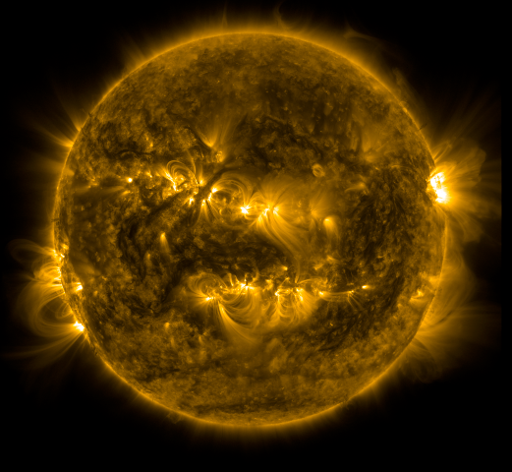
Scaling an image so it looks “good”: SSWIDL
Typically a version of the original data is plotted.
Clip data to some range: c = C(x)
Rescale: y = R(c)
Display using y and color table (colormap).

Slide 3
Scaling an image so it looks “good”:
Matplotlib / Astropy / Sunpy
Original data does not have to be changed.
Colors in displayed images of data are defined by a mapping from the original data to colormap indices.
Normalize to range [0,1] (can involve clipping): y = N(x)
Rescale in range [0,1]: z = f(y)
Mapping x → f(N(x)) relates data values to a colormap index.
Display x using mapping x → f(N(x)) and colormap.

Slide 4
Types of color maps
Sequential
change in lightness and often saturation of color incrementally, often using a single hue; should be used for representing information that has ordering, e.g. intensity
Diverging
change in lightness and possibly saturation of two different colors that meet in the middle at an unsaturated color; should be used when the information being plotted has a critical middle value, such as topography or when the data deviates around zero, e.g. magnetogram, Doppler velocity.
Qualitative
often are miscellaneous colors; should be used to represent information which does not have ordering or relationships, e.g. maps of different solar features.

Slide 5
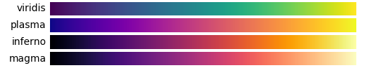
Perceptually uniform color maps
A perceptually uniform colormap has the property that if your data goes from 0.1 to 0.2, this should create about the same perceptual change as if your data goes from 0.8 to 0.9.
Matplotlib uses the CAM02-UCS model of perceptual distance.

Slide 6
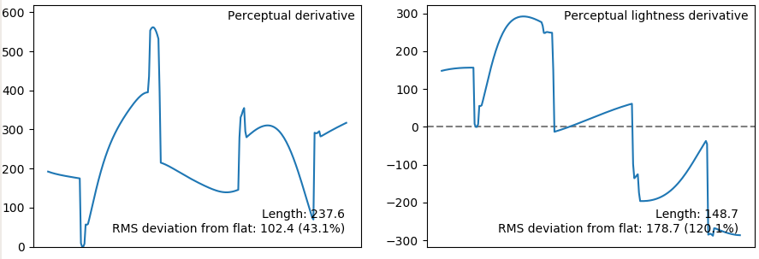
Perceptual deltas
A "perceptually uniform" colormap is one for which the "perceptual deltas" plot makes a simple horizontal line. This is essentially the derivative of the colormap in perceptual space with respect to the data.

Slide 7
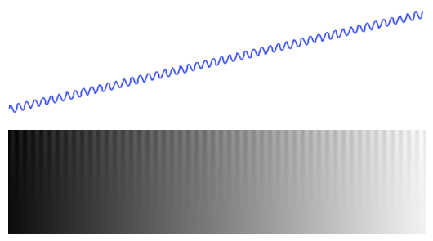
Test image: sine wave plus ramp
The test image consists of a sine wave superimposed on a ramp function. The sine wave amplitude is set so that the range from peak to trough represents a series of features that are 10% of the total data range. The amplitude of the sine wave is modulated from its full value at the top of the image to 0 at the bottom. Here the image is displayed using a linear grey colour map.
http://peterkovesi.com/projects/colourmaps/
http://peterkovesi.com/projects/colourmaps/colourmaptestimage.html

Slide 8
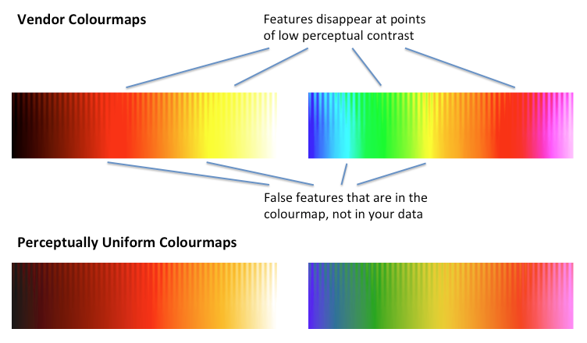
Test image with colormaps
http://peterkovesi.com/projects/colourmaps/
http://peterkovesi.com/projects/colourmaps/colourmaptestimage.html

Slide 9
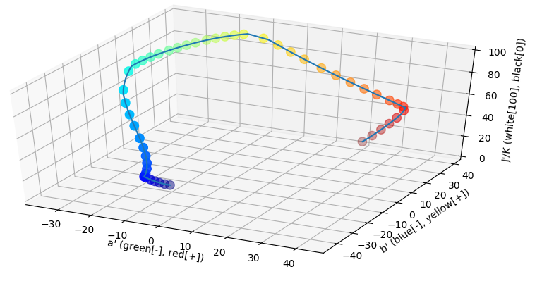
Colormap in the color space
matplotlib jet colormap
CAM02-UCS colorspace

Slide 10
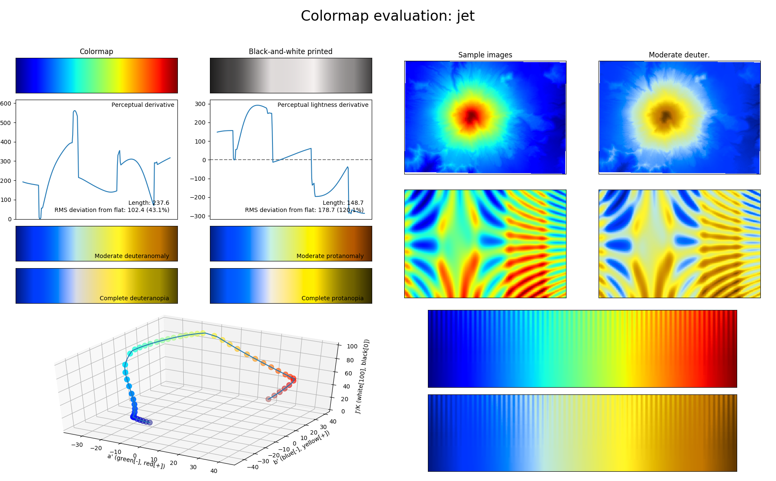
Mt. St. Helens height map
computed 2d surface
test image

Slide 11
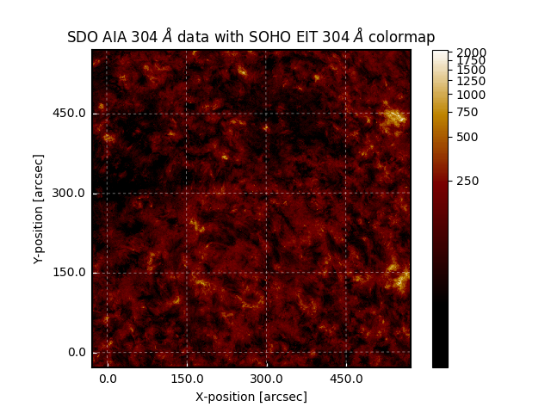
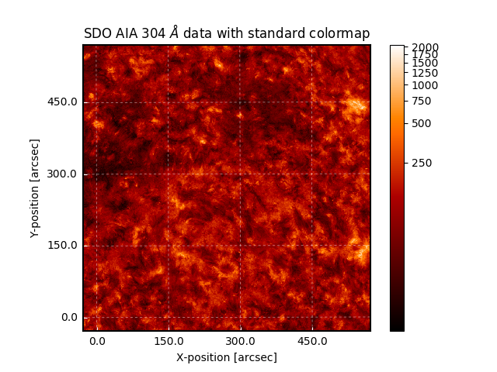
Same data, image scaling, different color table
Stark demarcation between light and dark features
Smooth gradation between features is accentuated
Identical AIA 304 image from July 26, 2010

Slide 12
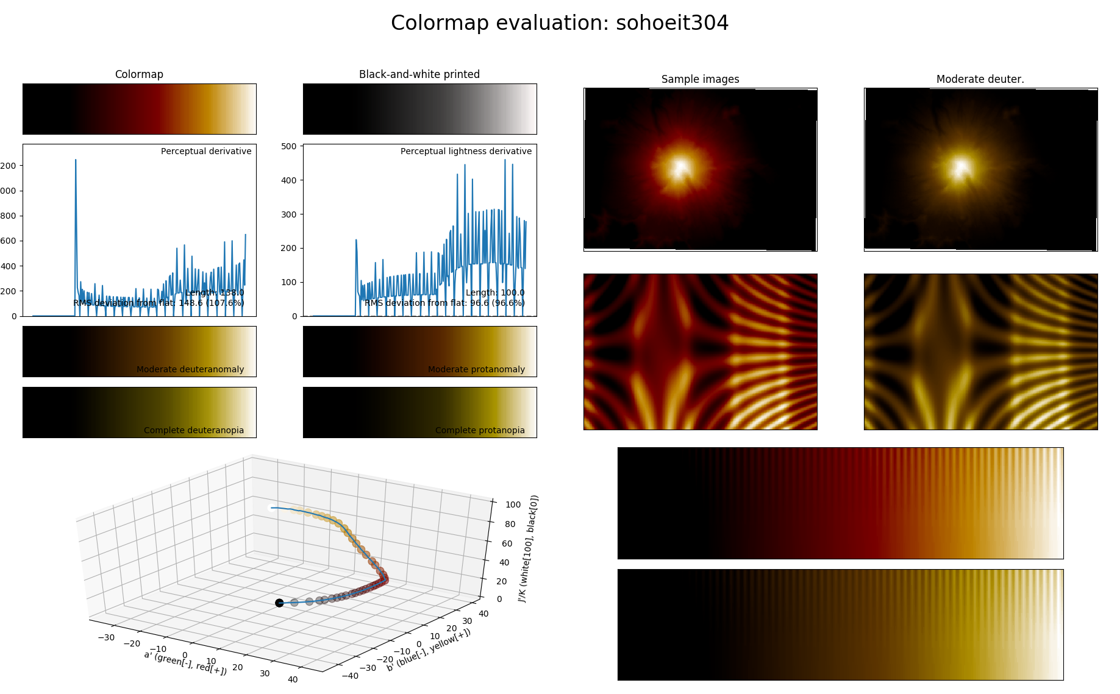

Slide 13
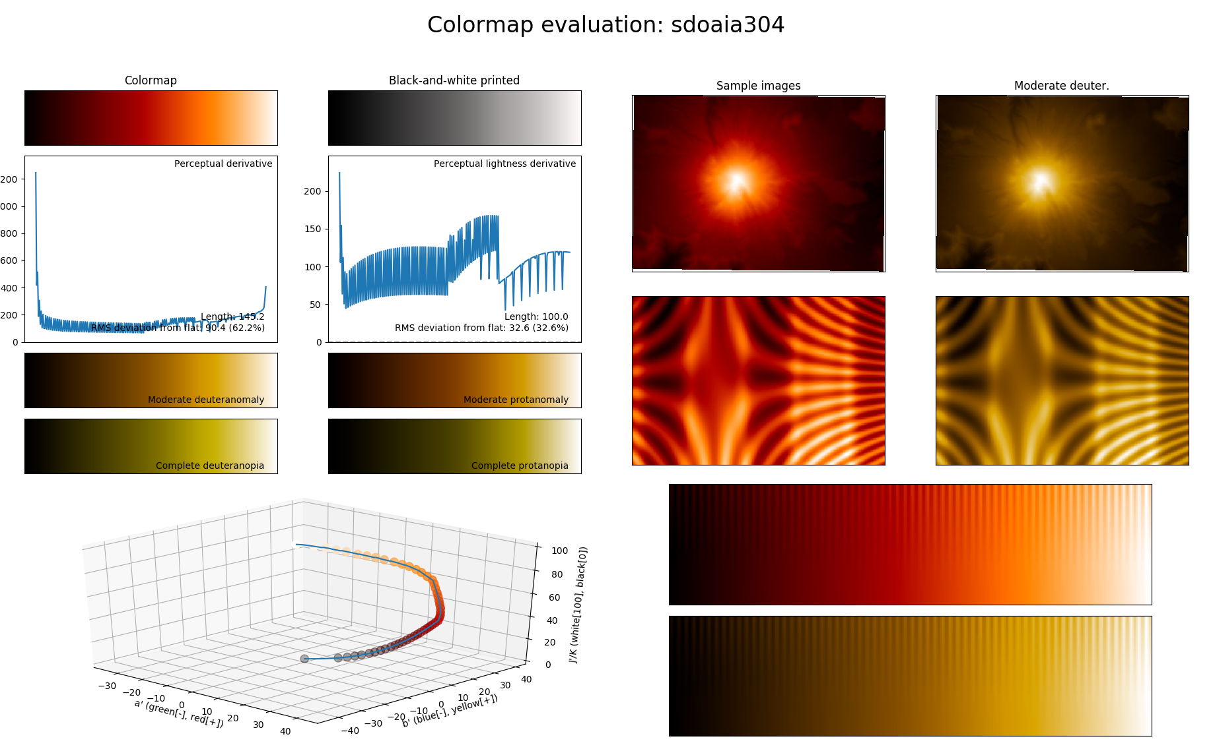

Slide 14
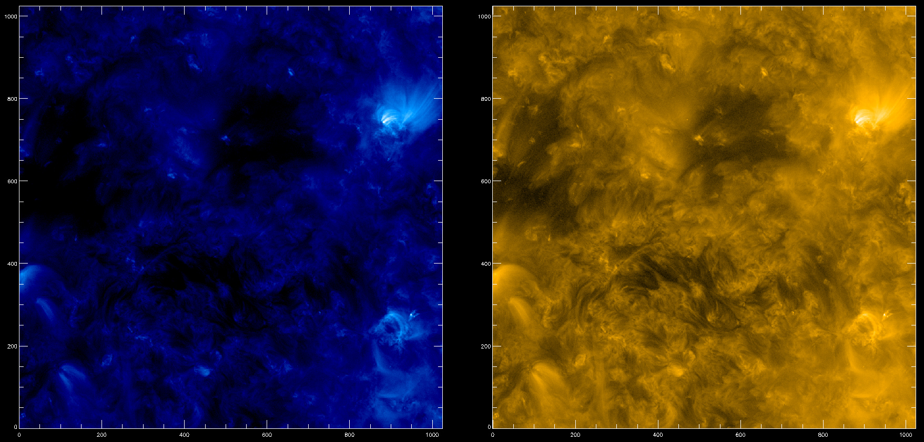
Same data, image scaling, different color table (2)
High-end detail is emphasized
Low-end detail is emphasized
SOHO EIT 171 Color Table
SDO AIA 171 Color Table
Identical AIA 171 Image from July 26, 2010

Slide 15
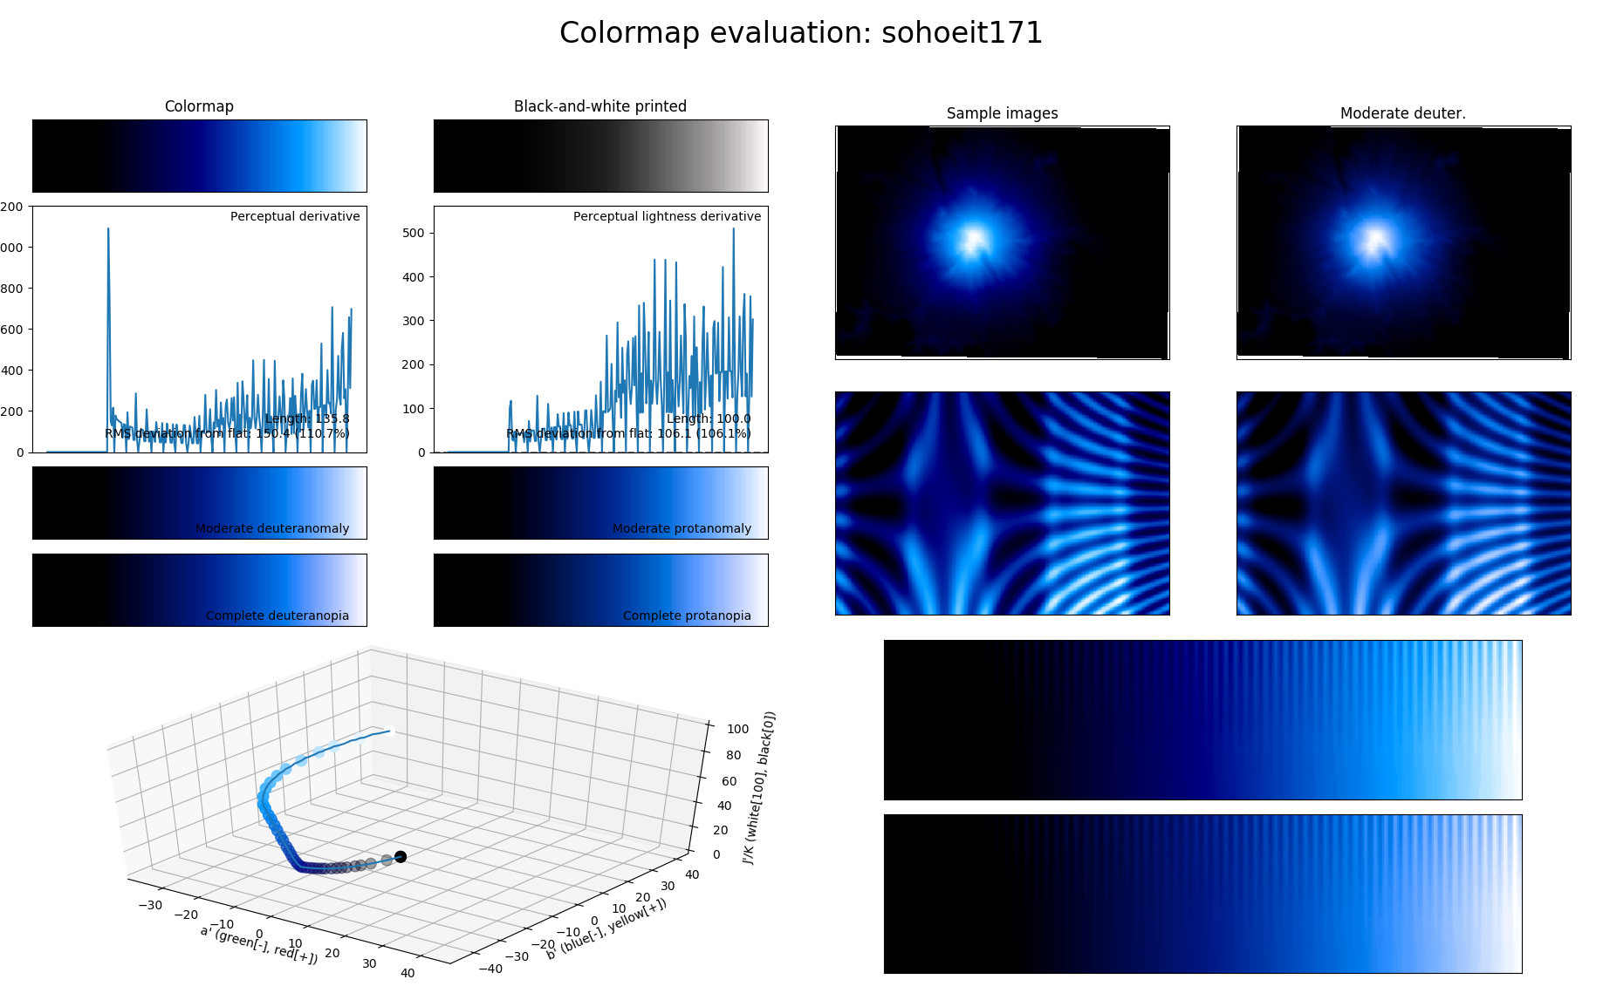

Slide 16
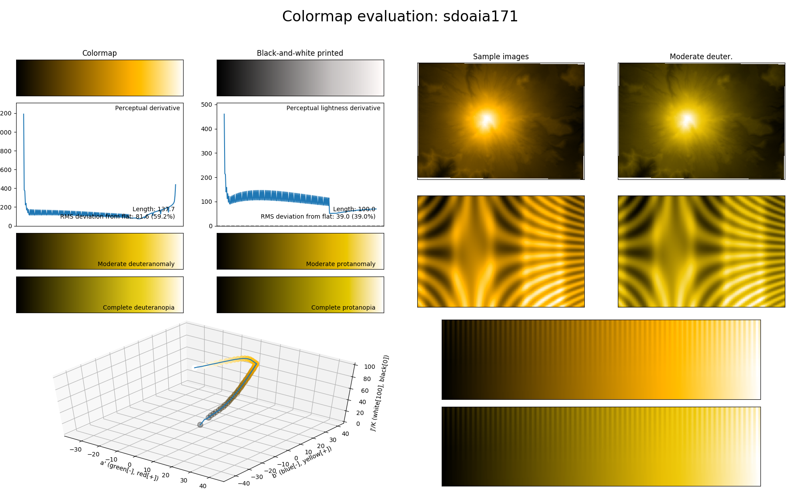

Slide 17
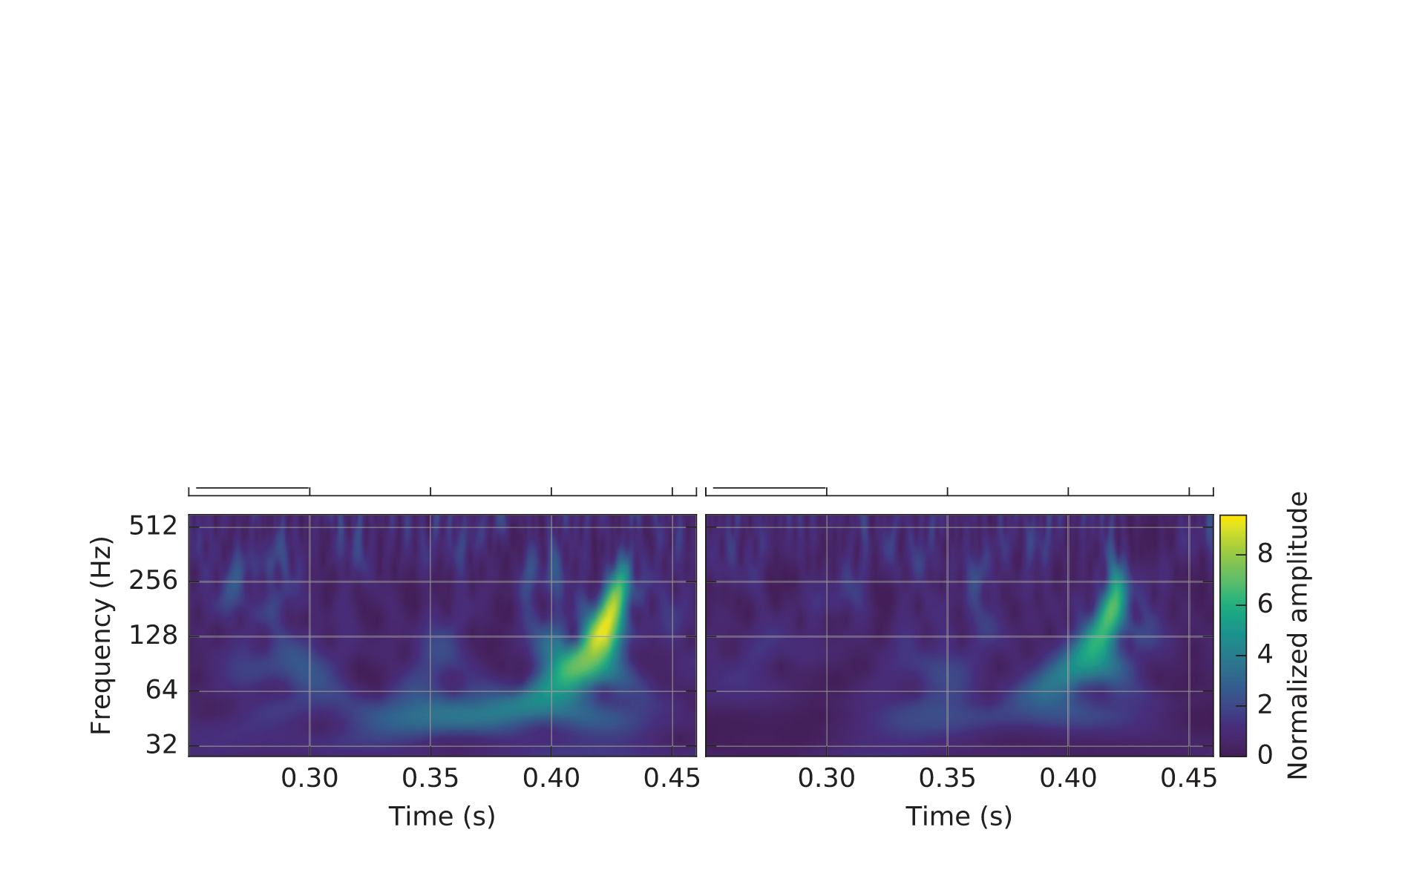
Other data...
matplotlib viridis colormap

Slide 18
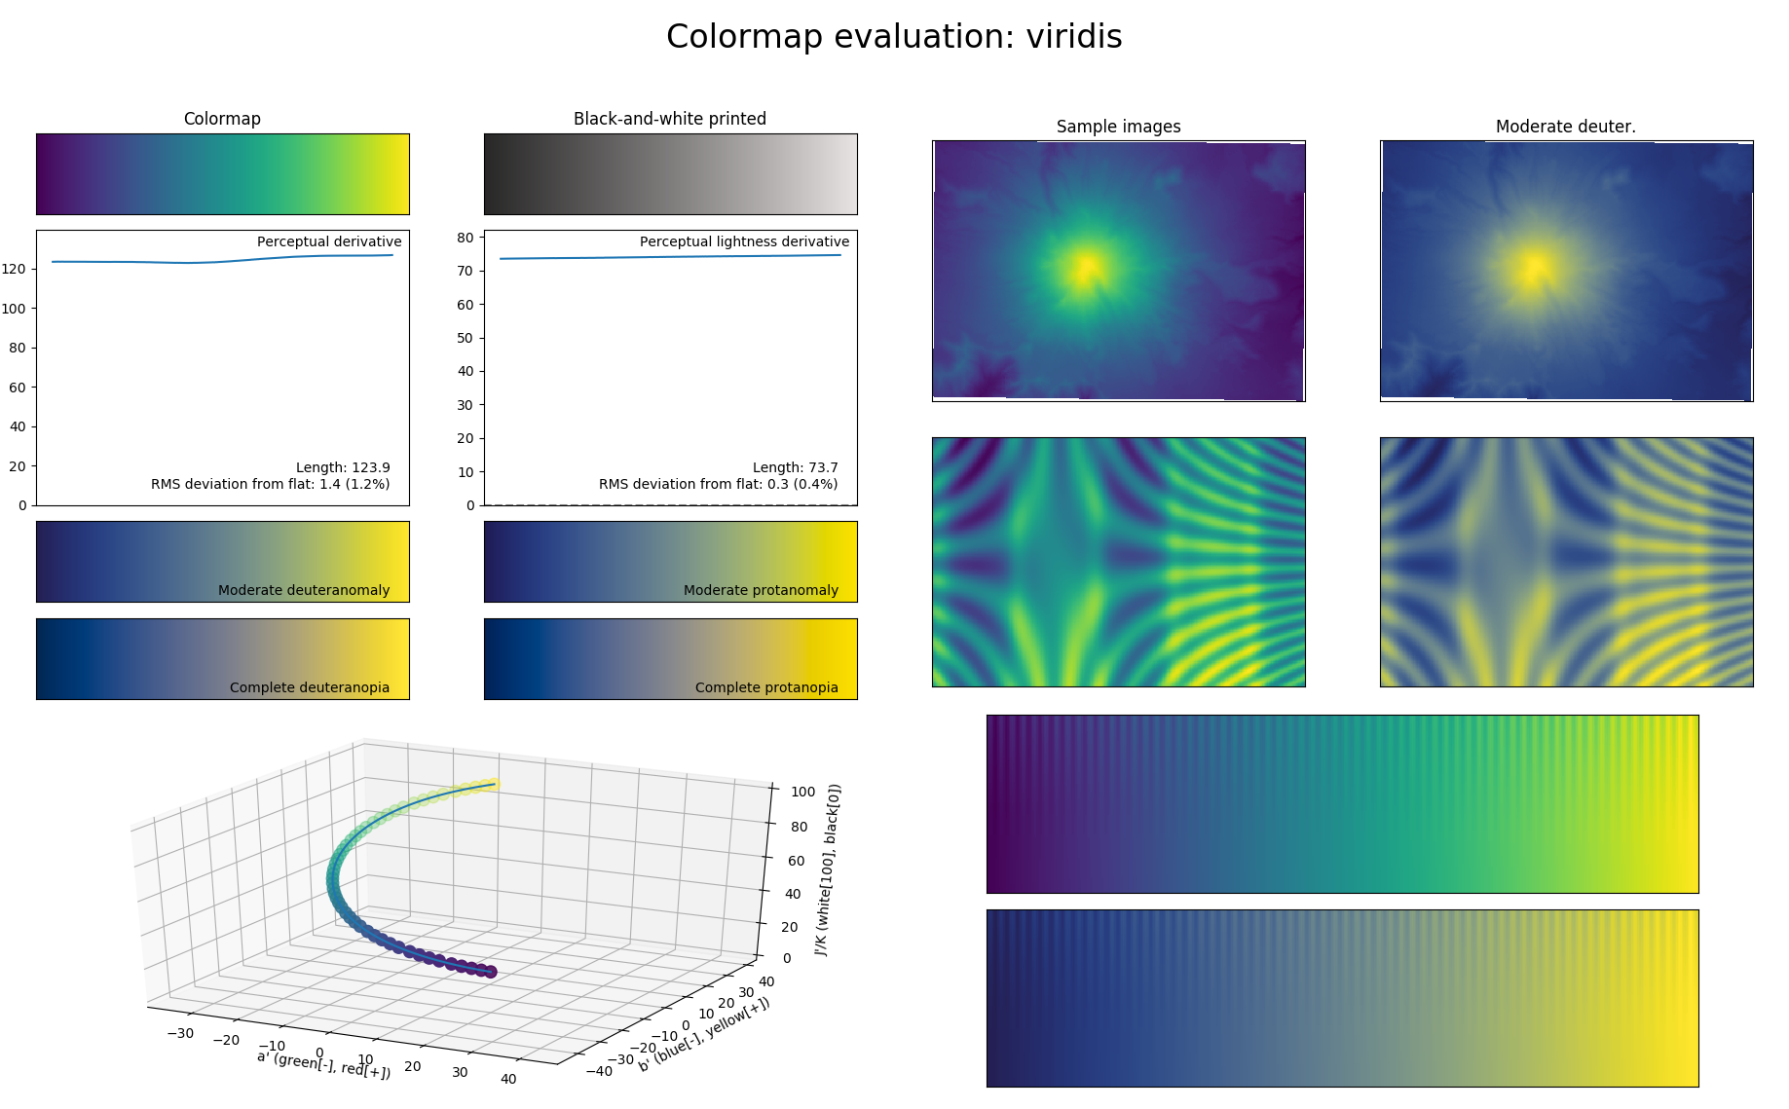

Slide 19
Try it for yourself
Follow the SunPy installation instructions on sunpy.org
git clone https://github.com/wafels/viscm
Change directory to where you cloned the git repository above
git checkout -b sunpy
python setup.py install
python -m viscm view sdoaia171
The main repository https://github.com/matplotlib/viscm contains much more information about the perception of colormaps and how to make your own perceptually uniform colormaps.

Slide 20
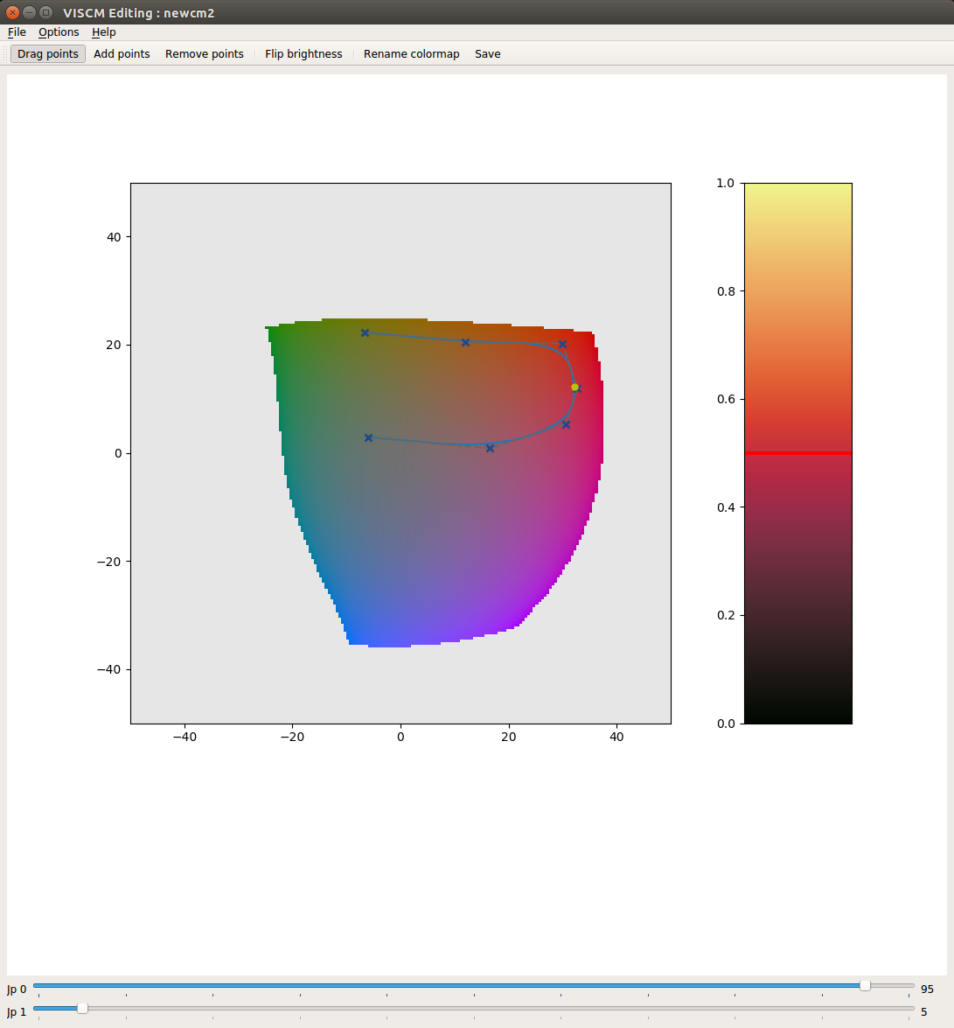
Design your own AIA 304Å scaling function and colormap
Requirements
Reddish-orangey colors (because that’s what the community expects now).
As perceptually uniform as we can make it.
python -m viscm edit

Slide 21
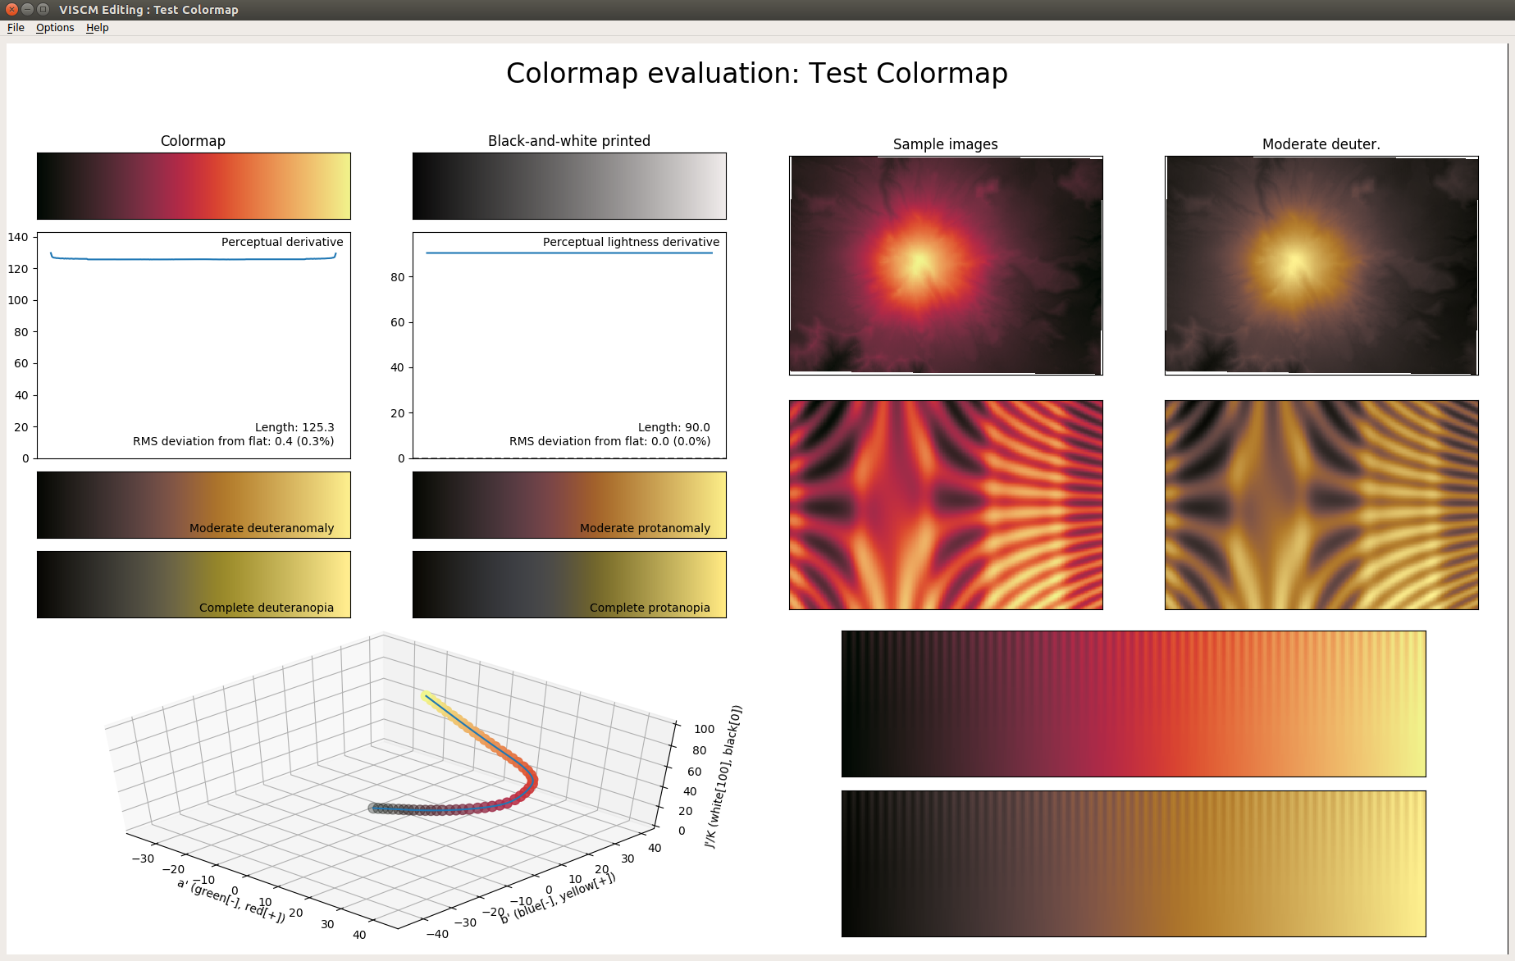

Slide 22
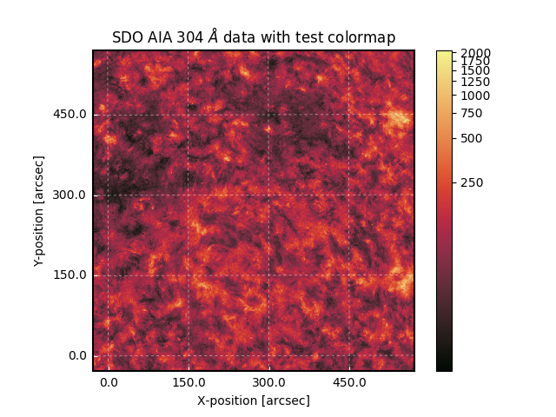

Slide 23
Conclusions
Many colormaps used in solar physics have large variation in their perception.
Advice is available on the selection of colormaps to best display your data, taking into account common types of colorblindness.
Tools are available to test and design colormaps using their perception as a criterion.
We can understand how the colormap is biasing our perception.

Slide 24
More information
http://matplotlib.org/users/colormaps.html
https://bokeh.github.io/colorcet/
http://www.kennethmoreland.com/color-advice/
https://gist.github.com/endolith/2719900#id7
https://mycarta.wordpress.com/2012/10/14/the-rainbow-is-deadlong-live-the-rainbow-part-4-cie-lab-heated-body/
http://ccom.unh.edu/sites/default/files/publications/Ware_1988_CGA_Color_sequences_univariate_maps.pdf
http://www.research.ibm.com/people/l/lloydt/color/color.HTM
https://en.wikipedia.org/wiki/CIE_1931_color_space
https://en.wikipedia.org/wiki/Lab_color_space
https://en.wikipedia.org/wiki/CIECAM02
http://dba.med.sc.edu/price/irf/Adobe_tg/models/cielab.html
https://www.youtube.com/watch?v=xAoljeRJ3lU
https://www.youtube.com/watch?v=TojFwkglCKs
https://bids.github.io/colormap/
http://peterkovesi.com/projects/colourmaps/
http://colour-science.org/
http://python-colormath.readthedocs.io/en/latest/
https://pypi.python.org/pypi/ciecam02/
http://markkness.net/colorpy/ColorPy.html

Slide 25
Updates to this presentation
Any updates to this presentation will be made here:
https://docs.google.com/presentation/d/1nFfxHEDElUu3tQtQgxjnWw6FvWTGCN1UUGAlenAQelk/edit?usp=sharing

Slide 26
End

